Slide 1
AEM 2210
Financial Accounting
Chapter 07: Reporting and Interpreting Cost of Goods Sold and Inventory
Professor Sinclair
Spring 2018

Slide 2
Chapter 07 Learning Objectives
Apply the cost principle to identify the amounts that should be included in inventory and the expense matching principle to determine cost of goods sold for typical retailers, wholesalers, and manufacturers
Report inventory and cost of goods sold using the four inventory costing methods
Decide when the use of different inventory costing methods is beneficial to a company
Report inventory at the lower of cost or market (LCM)
Evaluate inventory management using the inventory turnover ratio
Compare companies that use different inventory costing methods
Understand methods for controlling inventory, analyze the effects of inventory errors on financial statements, and analyze the effects of inventory on cash flows

Slide 3
Where we are on the Income Statement
Income Statement for FY 2016
Revenues | 1,000
COGS | (600)
Gross Profit | 400
SG&A | (305)
Operating Income | 95
Interest Expense | (16)
Other Income (Expense) | (4)
Gains (Losses) | 25
Earnings before Taxes | 100
Tax Expense | (35)
Net Income | 65
EPS | 0.065

Slide 4
Where we are on the Balance Sheet
Balance Sheet as of 12/31/2016
Assets |  |  | Liabilities
Cash | 200 |  | Accounts Payable | 100
Accounts Receivable, gross | 200 |  | Salaries Payable | 30
(Allow. For Doubtful Accounts) | (10) |  | Current Portion of LT Debt | 50
Investments in Other Companies | 100 |  | Other | 70
Inventory | 230 |  | Current Liabilities | 250
Prepaid Assets | 120
Current Assets | 840 |  | Warranty Liabilities | 20
 |  |  | Contingent Liabilities | 40
PP&E, gross | 1000 |  | Deferred Tax Liabilities, net | 80
(Accumulated Depreciation) | (250) |  | Capital Lease Obligation | 100
Intangibles, net | 150 |  | Bonds, net | 600
Long-term Assets | 900 |  | Long-term Liabilities | 840
 |  |  | Owners’ Equity
 |  |  | Common Stock | 50
 |  |  | APIC | 450
 |  |  | Treasury Stock | (10)
 |  |  | Other | 10
 |  |  | Retained Earnings | 150
 |  |  | Owners’ equity | 650
Total Assets | 1740 |  | Total Liabilities & OE | 1740

Slide 5
Inventory
Inventory: Asset a company holds for sale or for use in the production of goods for sale in the ordinary course of business
Inventory costs include all “applicable expenditures and charges directly or indirectly incurred in bringing an article to its existing condition and location”¹
Purchase Price of Inventory
- Purchase Returns, Allowances, and Discounts
Net Purchases
+ Transportation Costs (if F.O.B. shipping)
Cost of Goods Purchased
¹ Accounting Standard Codification (ASC) Topic 330 ‘Inventory’
 | Service Provider | Retailer | Manufacturer
Types of Inventory: | Very little inventory (if any) | Inventory purchased from 3rd party | Raw Materials + Work in Process + Finished Goods Total Inventory

Slide 6
Inventory Management
The primary goals of inventory management are to have sufficient quantities of high-quality inventory available to serve customers’ needs while minimizing the costs of carrying inventory (i.e., costs related to production, storage, obsolescence, and financing).
Sufficient Quantity
purchasing or producing too few units can cause stock-outs, resulting in lost sales revenue and decreased customer satisfaction
Quality Inventory
Low-quality inventory leads to customer dissatisfaction, returns, and declines in future sales
Inventory costs
purchasing too many units increases storage costs as well as interest costs to finance the purchases. It may even lead to losses if the merchandise cannot be sold at normal prices.

Slide 7
Items Included in Inventory
Inventory is tangible property that is either held for sale in the normal course of business or used in producing goods or services for sale.
Merchandisers (wholesale or retail businesses) hold merchandise inventory, which is goods (or merchandise) held for resale in the normal course of business. The goods usually are acquired in a finished condition and are ready for sale without further processing.
When merchandise inventory is purchased, the merchandise inventory account is increased. When the goods are sold, cost of goods sold is increased and merchandise inventory is decreased.

Slide 8
Items Included in Inventory
Manufacturers hold three types of inventory:
Raw materials inventory: Items acquired for processing into finished goods. These items are included in raw materials inventory until they are used, at which point they become part of work in process inventory.
Work in process (WIP) inventory: Goods in the process of being manufactured but not yet complete. Direct labor and factory overhead* are also added to WIP inventory. When completed, work in process inventory becomes finished goods inventory.
Finished goods inventory: Manufactured goods that are complete and ready for sale.
Direct labor refers to the earnings of employees who work directly on the products being manufactured.
Factory overhead includes manufacturing costs such as the costs of heat, light, and power to operate the factory.
When finished goods are sold, cost of goods sold (COGS) is increased and finished goods inventory decreases

Slide 9
Costs Included in Inventory Purchases
The cost principle requires that inventory be recorded at the price paid or the consideration given.
Inventory cost includes the sum of the costs incurred in bringing an article to usable or salable condition and location.
Invoice cost
freight-in
inspection costs
preparation costs.
NOTE: Any purchase returns and allowances or purchase discounts taken reduce the cost of inventory.
Costs related to selling inventory (such as marketing costs and salaries) are incurred after the inventory is ready for use. So, they should be included in selling, general, and administrative expenses in the period they were incurred.

Slide 10
What about Inventory-Related costs?
Other costs incurred to bring an item to market:
Excise, VAT, and/or sales taxes
Storing and insuring inventory
Transporting inventory from a warehouse to a retail store
Evaluate the cost/benefit of tracking and allocating costs to each individual product
Example: Should Wal-Mart allocate transportation costs across the millions of products it ships each year by weight? By volume? By dollar value? By minutes of handling time?
If cost allocation is impracticable and immaterial, firms expense these costs in the period incurred

Slide 11
Materiality
Incidental costs, such as inspection and preparation costs, do not have to be assigned to the inventory cost if they are not material. Many companies use the invoice price, less returns and discounts to assign a unit cost to raw materials or merchandise. Companies will then report other indirect expenditures separately as an expense.
Most companies report inventory cost as:
Invoice Price XX
Less Returns - XX
Less Discounts - XX
Total Inventory Cost XX

Slide 12
Inventory Cost Flow Assumptions

Slide 13
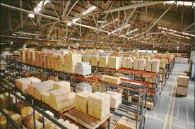
Inventory Cost Flow Assumptions
Firms purchase inventory throughout the year, resulting in different purchase prices on different purchase dates
This makes it challenging and time-consuming for firms to determine which goods from which purchase date are:
Still on hand at year-end Ending Inventory (Bal. Sheet)
Gone COGS (Income Statement)

Slide 14
Inventory Costing Methods
When inventory costs have changed during an accounting period, which inventory costs are treated as sold or remain in inventory can turn profits into losses and cause companies to pay or save millions in taxes.
What amount is recorded as cost of goods sold when inventory is sold?
The answer depends on which specific goods we assume are sold.
Four (4) generally accepted inventory costing methods are available for determining cost of goods sold:
Specific identification
First-in, first-out (FIFO)
Last-in, first-out (LIFO)
Average cost
The four inventory costing methods are alternative ways to assign the total dollar amount of goods available for sale between ending inventory and cost of goods sold.
The choice of an inventory costing method does NOT have to be based on the physical flow of goods.

Slide 15
Inventory Cost Flow Assumptions
Managers should select the inventory cost flow assumption that most accurately reflects their firm’s economic performance
^Assuming that prices are rising over time (as they generally are in many industries)
Cost Flow Assumption | FIFO | LIFO
Flow of goods assumption | First purchases sold first | Last purchases sold first
COGS reflects | Oldest costs (lower^) | Most recent costs (higher^)
Net income is | Higher^ | Lower^
End of year inventory values reflect | Goods most recently purchased at current replacement cost (higher^) | Goods purchased a long time ago (lower^)

Slide 16
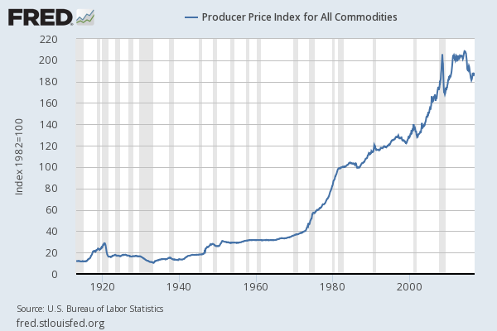
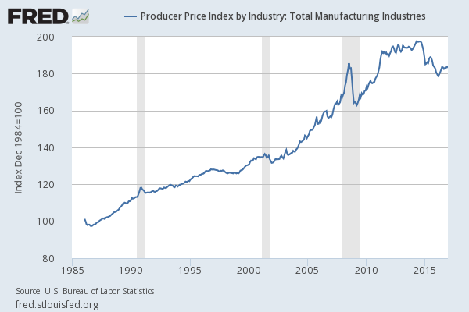
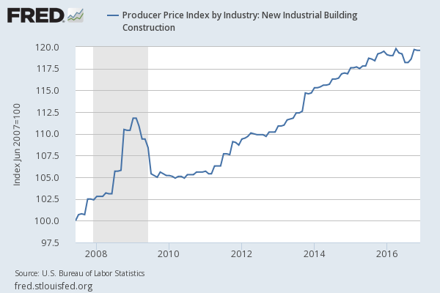
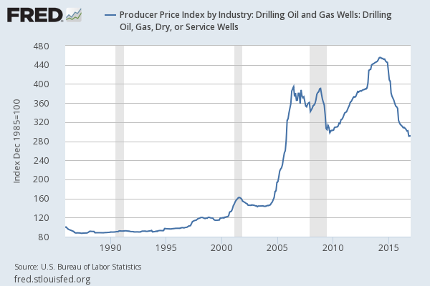
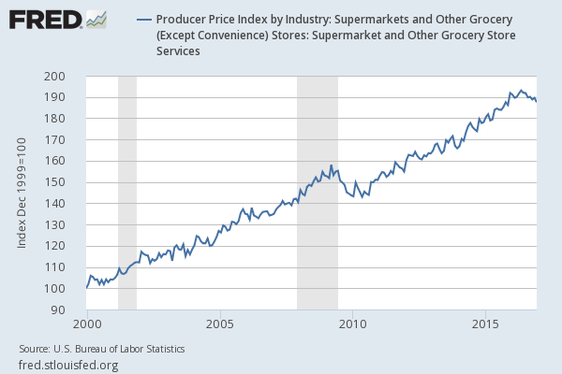
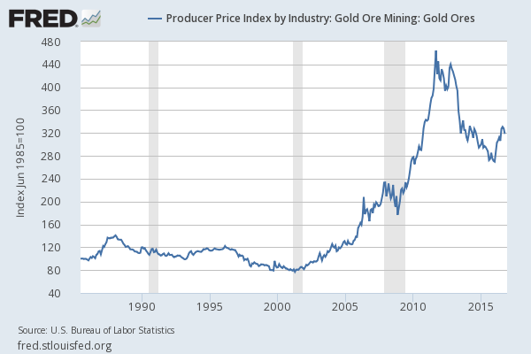
Producer Price Index Patterns over Time
All Commodities
Total Manufacturing Industries
New Industrial Building Construction
Drilling Oil and Gas Wells
Supermarkets and Other Grocery
Gold Ore Mining

Slide 17
Which Cost Flow Assumption is “Best”?
* NOTE: Using the specific identification method, we know the specific cost of each unit that is sold. It is most commonly used in businesses that have low sales volume of high-dollar items (i.e., car dealerships, exclusive jewelry stores, custom builders). The specific identification method is impractical when large quantities of similar items are stocked.
First-In, First-Out
Last-In, First-Out
Average Cost
Balance Sheet Focus:
Ending inventory approximates current replacement cost
Income Statement Focus:
Better matching of current costs (as COGS) with revenues
Blended:
Inventory price changes are smoothed
over time

Slide 18
Inventory Cost Flow Assumptions
The best of both worlds (when prices are rising):
Higher net income with FIFO for financial reporting to shareholders
Lower taxable income with LIFO for tax reporting to the IRS
Congress will NOT let firms have the best of both worlds
“LIFO Conformity Rule” (IRC §472(c)): if firms use LIFO for tax reporting, they have to also use LIFO for financial reporting
Only instance where tax law affects financial reporting
Many firms use more than one cost flow assumption to value different inventory components or products
LIFO is popular for equipment manufacturers and chemical firms

Slide 19
Inventory Tracking Systems

Slide 20
Inventory Tracking Systems
1. Perpetual Inventory System
Firm is “perpetually” updating its inventory account
When goods are purchased, inventory goes up
When sales are made, inventory goes down and COGS go up
2. Periodic Inventory System
Firm does not update its inventory account until the end of each period
The firm does not necessarily know the exact cost of each individual inventory item sold, so inventory and COGS CANNOT be updated at each sale
Extremely common in practice (even at sophisticated firms)
Firm is “periodically” updating its inventory account
IMPORTANT: Under this system, firms still track inventory in UNITS (i.e., the firm knows that 10 units were sold, the firm just doesn’t know the cost basis of each individual unit)

Slide 21
Comparing Inventory Tracking Systems
Perpetual
Advantage: More accurate financial statement information
Disadvantage: IT system to keep track of cost basis of every individual piece of inventory is expensive
Periodic
Advantage: Lower cost and effort because you only update inventory account and calculate COGS at the end of each period
Disadvantage: Because the firm assumes that Beginning Inventory + Purchases - Ending Inventory = Goods Sold, it is difficult to identify goods that were stolen, damaged, or spoiled

Slide 22
Computing COGS
Each accounting period starts with a stock of inventory called beginning inventory. During the accounting period, new purchases are added to inventory. The sum of the two amounts is the goods available for sale during that period.
What remains unsold at the end of the period becomes ending inventory on the balance sheet. The portion of goods available for sale that is sold becomes cost of goods sold on the income statement. The ending inventory for one accounting period becomes the beginning inventory for the next period.
Beginning Inventory $40,000
+ Purchases 55,000
Goods Available for Sale 95,000
- Ending Inventory ( 35,000)
Cost of Goods Sold $60,000
Balance Sheet
Income Statement

Slide 23
Inventory Example

Slide 24
Inventory Example
Example:
CB2 is a home goods retailer. As of 12/31/2016, CB2’s ending inventory is reported at $12,000 and consists of 12 kitchen tables purchased for $1,000 each. During 2017 CB2 makes the following table purchases and sales:
On 12/31/2017 CB2 counts 8 tables in its warehouse.
 | Units | Price/Unit | $ Amount
Beg. Inventory (01/01) | 12 | $1,000 | $12,000
+ Purchase #1 (02/01) | 10 | $1,100 | $11,000
+ Purchase #2 (04/14) | 10 | $1,200 | $12,000
+ Purchase #3 (08/05) | 5 | $1,300 | $6,500
+ Purchase #4 (11/11) | 15 | $1,380 | $20,700
Goods Available for Sale | 52 |  | $62,200
- Sale #1 (03/25) | 8 | $1,400 | ?
- Sale #2 (06/11) | 20 | $1,600 | ?
- Sale #3 (12/16) | 16 | $1,700 | ?
End. Inventory (12/31) | 8 |  | ?
= COGS

Slide 25
Inventory Example
We need to calculate:
COGS for 44 tables sold
Ending inventory value of 8 tables
Two inventory cost flow assumptions:
FIFO
LIFO
Two inventory tracking systems:
Periodic (calculate COGS at end of period)
Perpetual (calculate COGS at time of every sale)

Slide 26
Cost of Goods Sold
Inventory
Beg. Bal.
Purchases
End. Bal.
Beg. Inventory
+ Purchases
Goods Available for Sale
- End. Inventory COGS
COGS

Slide 27
Inventory Example: Periodic System
Inventory Example:
 | Periodic System | Perpetual System
FIFO | X
LIFO | X

Slide 28
Inventory Example: Periodic System
 | Units | Price/Unit | $ Amount
Beg. Inventory (01/01) | 12 | $1,000 | $12,000
+ Purchase #1 (02/01) | 10 | $1,100 | $11,000
+ Purchase #2 (04/14) | 10 | $1,200 | $12,000
+ Purchase #3 (08/05) | 5 | $1,300 | $6,500
+ Purchase #4 (11/11) | 15 | $1,380 | $20,700
Determine when the 8 units remaining were purchased and calculate the ending inventory value
Periodic System & FIFO
Beginning Inventory: 12 tables $12,000
+ Purchases: 40 tables 50,200
Goods Available for Sale: 52 tables 62,200
- Ending Inventory: 8 tables 11,040
Cost of Goods Sold: 44 tables $51,160*
*COGS = 12 @ $1,000 + 10 @ $1,100 + 10 @ $1,200 + 5 @ $1,300 + 7 @ $1,380 _________________________________________________________________________
Periodic System & LIFO
Beginning Inventory: 12 tables $12,000
+ Purchases: 40 tables 50,200
Goods Available for Sale: 52 tables 62,200
- Ending Inventory: 8 tables 8,000
Cost of Goods Sold: 44 tables $54,200*
*COGS = 15 @ $1,380 + 5 @ $1,300 + 10 @ $1,200 + 10 @ $1,100 + 4 @ $1,000

Slide 29
Inventory Example: Periodic System; FIFO vs. LIFO
Inventory System: | Periodic
 | FIFO | LIFO
Revenues | $70,400 | $70,400
- COGS | (51,160) | (54,200)
Gross Profit | 19,240 | 16,200
Ending Inventory | $11,040 | $8,000

Slide 30
Inventory Example: Perpetual System
Inventory Example:
 | Periodic System | Perpetual System
FIFO |  | X
LIFO |  | X

Slide 31
Inventory Example: Perpetual System & FIFO
 | Units | Price/Unit | $ Amount
Beg. Inventory (01/01) | 12 | $1,000 | $12,000
+ Purchase #1 (02/01) | 10 | $1,100 | $11,000
+ Purchase #2 (04/14) | 10 | $1,200 | $12,000
+ Purchase #3 (08/05) | 5 | $1,300 | $6,500
+ Purchase #4 (11/11) | 15 | $1,380 | $20,700
Calculate COGS at every sale:
COGS_{FIFO} for Sale #1 (8 units) on 3/25 =
COGS_{FIFO} for Sale #2 (20 units) on 6/11 =
COGS_{FIFO} for Sale #3 (16 units) on 12/16 =
∑ COGS_{FIFO} =
Ending Inventory_{FIFO} =
Check our work:
Beginning Inventory: 12 tables $12,000
+ Purchases: 40 tables 50,200
Goods Available for Sale: 52 tables 62,200
- Ending Inventory: 8 tables 11,040
Cost of Goods Sold: 44 tables $51,160
 | Units | Price/Unit
- Sale #1 (03/25) | 8 | $1,400
- Sale #2 (06/11) | 20 | $1,600
- Sale #3 (12/16) | 16 | $1,700
(8 x $1,000)_{Beg. Inv.} = $8,000
(4 x $1,000)_{Beg. Inv.} + (10 x $1,100)_{02/01} + (6 x $1,200)_{04/14} = $22,200
(4 x $1,200) _{04/14} + (5 x $1,300) _{08/05} + (7 x $1,380) _{11/11} = $20,960
$51,160
(8 x $1,380)_{11/11} = $11,040

Slide 32
Inventory Example: Perpetual System & LIFO
 | Units | Price/Unit | $ Amount
Beg. Inventory (01/01) | 12 | $1,000 | $12,000
+ Purchase #1 (02/01) | 10 | $1,100 | $11,000
+ Purchase #2 (04/14) | 10 | $1,200 | $12,000
+ Purchase #3 (08/05) | 5 | $1,300 | $6,500
+ Purchase #4 (11/11) | 15 | $1,380 | $20,700
Calculate COGS at every sale:
COGS_{LIFO} for Sale #1 (8 units) on 3/25 =
COGS_{LIFO} for Sale #2 (20 units) on 6/11 =
COGS_{LIFO} for Sale #3 (16 units) on 12/16 =
∑ COGS_{FIFO} =
Ending Inventory_{FIFO} =
Check our work:
Beginning Inventory: 12 tables $12,000
+ Purchases: 40 tables 50,200
Goods Available for Sale: 52 tables 62,200
- Ending Inventory: 8 tables 9,200
Cost of Goods Sold: 44 tables $53,000
 | Units | Price/Unit
- Sale #1 (03/25) | 8 | $1,400
- Sale #2 (06/11) | 20 | $1,600
- Sale #3 (12/16) | 16 | $1,700
(8 x $1,100)_{02/01} = $8,800
(10 x $1,200) _{04/14} + (2 x $1,100)_{02/01} + (8 x $1,000)_{Beg. Inv.} = $22,200
(15 x $1,380) _{11/11} + (1 x $1,300) _{08/05} = $22,000
$53,000
(4 x $1,000) _{Beg.} _{Inv.} + (4 x $1,300) _{08/05} = $9,200

Slide 33
LIFO Layers
LIFO “layers” arise because goods with different cost bases are assumed to be in ending inventory
Remember that this is an assumption; the physical tables purchased prior to 2017 do not literally have to be on hand at 12/31/2017
4 tables @ $1,300/unit purchased on 08/05/2017
4 tables @ $1,000/unit purchased prior to 2017

Slide 34
Inventory Example: Summary
Notes:
FIFO_{periodic} values = FIFO_{perpetual} values
LIFO_{periodic} values generally differ from LIFO_{perpetual} values
Whether LIFO_{periodic} or LIFO_{perpetual} yields a higher or lower COGS and ending inventory values is a function of when inventory is purchased and sales are made
Inventory System: | Periodic |  | Perpetual
 | FIFO | LIFO | FIFO | LIFO
Revenues | $70,400 | $70,400 | $70,400 | $70,400
- COGS | (51,160) | (54,200) | (51,160) | (53,000)
Gross Profit | 19,240 | 16,200 | 19,240 | 17,400
Ending Inventory | $11,040 | $8,000 | $11,040 | $9,200

Slide 35
Inventory Example: Average Cost
When using Average Cost (or weighted average method), assign the average cost of goods available for sale to COGS. Average cost is determined by dividing the cost of goods available for sale by the number of units available for sale. The average cost method uses the weighted average unit cost of the goods available for sale for both COGS and ending inventory.
 | Units | Price/Unit | $ Amount
Beg. Inventory (01/01) | 12 | $1,000 | $12,000
+ Purchase #1 (02/01) | 10 | $1,100 | $11,000
+ Purchase #2 (04/14) | 10 | $1,200 | $12,000
+ Purchase #3 (08/05) | 5 | $1,300 | $6,500
+ Purchase #4 (11/11) | 15 | $1,380 | $20,700
Average Cost
Beginning Inventory: 12 tables $12,000
+ Purchases: 40 tables 50,200
Goods Available for Sale: 52 tables 62,200
- Ending Inventory: 8 tables 9,569
Cost of Goods Sold: 44 tables $52,631
Average cost: $62,200 / 52 = $1,196.15/u

Slide 36
Inventory Costing Methods: Financial Statement Effects
Each of the four inventory costing methods is in conformity with GAAP and the tax law. To understand why managers choose different methods under different circumstances, we must first understand their effects on the income statement and balance sheet.
In periods of rising prices:
FIFO will provide the lowest COGS amount. This is because it uses the older costs, which tend to be lower, to arrive at this amount. LIFO will provide the highest COGS amount. This is because it uses the most recent costs, which tend to be higher, to arrive at this amount.
FIFO results in the highest net income, LIFO results in the lowest net income, and average cost results in net income that falls in the middle of these two.
Inventory System: | Periodic |  | Perpetual
Cost Flow Assumption: | FIFO | LIFO | FIFO | LIFO | Avg. Cost
Revenues | $70,400 | $70,400 | $70,400 | $70,400 | $70,400
- COGS | (51,160) | (54,200) | (51,160) | (53,000) | (52,631)
Gross Profit | 19,240 | 16,200 | 19,240 | 17,400 | 17,769
Ending Inventory | $11,040 | $8,000 | $11,040 | $9,200 | $9,569

Slide 37
LIFO Reserve

Slide 38
LIFO Reserve
To increase financial reporting transparency (because LIFO often results in inventory values that are much lower than replacement cost), firms using LIFO are required to disclose their inventory value as if they used FIFO:
12/31/2016 12/31/2015
Ending Inventory Value under FIFO $100M $88M
Less: LIFO Reserve ( 20M) (18M)
Ending Inventory Value under LIFO 80M 70M
Which inventory values are reported on this firm’s balance sheet?
$80M & $70M (the LIFO values)

Slide 39
LIFO Reserve Tells Us Three Things
Amount Inventory_{FIFO} > Inventory_{LIFO} at the end of period t, which also tells us the cumulative amount COGS_{LIFO} > COGS_{FIFO} over all prior periods through the end of period t
Cumulative COGS difference tells us about cumulative tax deferral
LIFO Reserve at 12/31/2016 $20M
x U.S. Federal Statutory Tax Rate x 0.35
Cumulative tax deferral from LIFO $ 7M
Change in LIFO Reserve from period t-1 to t tells us about the current period tax deferral
Tax deferral in 2016 = ΔLIFO Reserve * U.S. Statutory Tax Rate
= ($20M - $18M) * 35% = $700,000

Slide 40

Caterpillar’s LIFO Reserve (From 2015 10-k p. 77)
Inventories
Inventories are stated at the lower of cost or market. Cost is principally determined using the last-in, first-out (LIFO) method. The value of inventories on the LIFO basis represented about 60 percent of total inventories at December 31, 2015 and 2014. If the FIFO (first-in, first-out) method had been in use, inventories would have been $2,498 million and $2,430 million higher than reported at December 31, 2015 and 2014, respectively.
 |  | December 31,
(Millions of dollars) |  | 2015 |  |  |  | 2014
Raw materials |  | $ | 2,467 |  |  | $ | 2,986
Work-in-process |  | 1,857 |  |  |  | 2,455
Finished goods |  | 5,122 |  |  |  | 6,504
Supplies |  | 254 |  |  |  | 260
Total inventories |  | $ | 9,700 |  |  | $ | 12,205
What would Caterpillar’s 12/31/2015 ending inventory have been if the firm used FIFO?
$12,198M = $9,700M_{LIFO} + 2,498M_{LIFO Reserve}

Slide 41
LIFO Liquidations
When a LIFO company sells more inventory than it purchases or manufactures, items from beginning inventory become part of cost of goods sold. This is called a LIFO liquidation.
When inventory costs are rising, these lower-cost items in beginning inventory produce a higher gross profit, higher taxable income, and higher taxes when they are sold.
Many companies avoid LIFO liquidations and the accompanying increase in tax expense by purchasing sufficient quantities of inventory at year-end to ensure that ending inventory quantities are greater than or equal to beginning inventory quantities.
In practice, LIFO liquidations and extra tax payments can be avoided even if purchases of additional inventory take place after the sale of the item it replaces. Tax law allows LIFO to be applied as if all purchases during an accounting period took place before any sales and cost of goods sold were recorded. Thus, temporary LIFO liquidations can be eliminated by purchasing additional inventory before year-end. Most companies apply LIFO in this manner.

Slide 42
Public Finance and Financial Reporting
While U.S. GAAP allows companies to choose among FIFO, LIFO, and weighted average inventory methods, International Financial Reporting Standards (IFRS) currently prohibit the use of LIFO. GAAP allows different inventory accounting methods to be used for different types of inventory items and even for the same item in different locations. IFRS requires that the same method be used for all inventory items that have a similar nature and use. These differences can create comparability problems when one attempts to compare companies across international borders.
President Obama’s 2015 budget proposal to Congress included the repeal of LIFO as an inventory cost flow assumption for tax purposes
Estimated to raise $82+ billion of revenue over 10 years
www.savelifo.org

Slide 43
Changing Inventory Cost Flow Assumptions

Slide 44
Managers’ Choice of Inventory Methods
What motivates companies to choose different inventory costing methods? Most managers choose accounting methods based on two factors:
Net income effects (managers prefer to report higher earnings for their companies)
Income tax effects (managers prefer to pay the least amount of taxes allowed by law as late as possible)
Any conflict between the two motives is normally resolved by choosing one accounting method for external financial statements and a different method for preparing tax returns.
The choice of inventory costing method must also consider the Last-in, First-out Conformity Rule. This rule states that if last-in, first-out (LIFO) is used to compute taxable income, it must also be used to calculate inventory and cost of goods sold for financial statements.

Slide 45
Changing Inventory Cost Flow Assumptions
Acceptable voluntary accounting method change
Most voluntary accounting method changes require retrospective adoption
Report all previous period’s financial statements as if the new method had been used to maintain consistency
In practice, only the years presented in the annual report for the year the accounting method is adopted are re-calculated. The earliest Retained Earnings value presented is updated to reflect the prior year income statement effect of the change.
If retrospective application is impossible, apply the new method prospectively (i.e., current year and going forward)

Slide 46
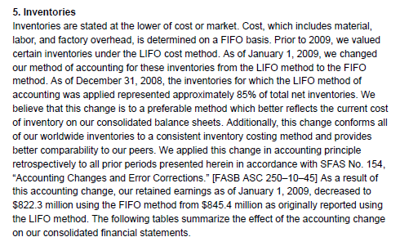
Sample Disclosure: LIFO to FIFO
IDEX Corp.’s 2009 Annual Report
Firm designs and manufactures fluidics systems and engineered products

Slide 47

Sample Disclosure: LIFO to FIFO
Generally,
COGS_{LIFO} > COGS_{FIFO} (so Retained Earnings_{LIFO} < Retained Earnings_{FIFO})
Inventory_{LIFO} < Inventory_{FIFO}
Here is what IDEX reported in its 2009 footnotes:
What is going on here?
Inventory costs may be falling over time, not rising
Feasible given high-tech nature of IDEX’s inventory

Slide 48
Sample Disclosure: FIFO to LIFO
Books A Million, Inc.’s 2003 Annual Report
Inventories.
Inventory counts are taken throughout the fiscal period. Store inventory counts are performed by an independent inventory service while warehouse inventory counts are performed internally. All physical inventory counts are reconciled to the Company's records. The Company accrues for inventory shortages based upon historical inventory shortage results.
Effective February 2, 2003, the Company changed from the first-in, first-out (FIFO) method of accounting for inventories to the last-in, first-out (LIFO) method. Management believes this change is preferable in that it achieves a more appropriate matching of revenues and expenses. The impact of this accounting change was to increase "Costs of Products Sold" in the consolidated statements of operations by $0.7 million for the fiscal year ended January 31, 2004. This resulted in an after-tax decrease to net income of $0.4 million or a decrease in net income per diluted share of $0.02. The cumulative effect of a change in accounting principle from the FIFO method to LIFO method is not determinable. Accordingly, such change has been accounted for prospectively. In addition, pro forma amounts from retroactively applying the change cannot be reasonably estimated and have not been disclosed.
Why is retrospective application so difficult when switching from FIFO to LIFO?
Difficult to determine which inventory units relate to which LIFO layer

Slide 49
Lower of Cost or Market Principle

Slide 50
Inventory Valuation: Lower of Cost or Market
Inventories should be measured initially at their purchase cost in conformity with the cost principle.
Inventory must be carried at the lower of historical cost or fair market value
Historical Cost: original cost of producing or purchasing the inventory
Fair Market Value: Market is defined as current replacement cost, but not greater than net realizable value (estimated selling price less reasonable costs of completion, disposal and transportation) and not less than net realizable value reduced by a normal sales margin
If Historical Cost ≤ Fair Market Value, Ending Inventory = Historical Cost
No adjusting entry is needed
If Fair Market Value < Historical Cost, Ending Inventory = Replacement Value
Adjusting entry is needed to write down inventory from original to replacement cost
Under U.S. GAAP, once inventory is written down to fair market value, essentially that becomes the new historical cost. It can't be later written up to its original cost if the market value subsequently rises.
But under IFRS, if you write inventory down, you can actually write it back up to the amount of the original cost. You just can never write it over the original cost.

Slide 51
Inventory Valuation: Lower of Cost or Market
Example:
Firm A, a TV retailer, purchases a Toshiba Version 1.0 TV for $400. The next week Toshiba releases Version 2.0, which reduces the market price of Version 1.0 to $300. As the “replacement” cost of Version 1.0 is now only $300, Firm A should reduce the carrying value of the Version 1.0 TV on its balance sheet by $100:
DR Inventory Impairment Loss (Lo.) 100
CR Inventory (A) 100
Can Firm A reverse the impairment charge in a future period if the inventory’s value subsequently increases?
No (under US GAAP)

Slide 52
Inventory Valuation: Lower of Cost or Market
Example: Speedway Co.
Consider that Speedway had compressors and tires in ending inventory. The 1,000 compressors should be recorded in ending inventory at the net realizable value of $200/unit because it is lower than the cost of $250.
NOTE: Since the market price of the tires ($110) is higher than the original cost of $100, no write-down is necessary. Recognition of holding gains on inventory is not permitted by GAAP.
Item | Quantity | Cost per Item | Net Realizable Value | LCM per Item | Total LCM
Compressors | 1,000 | $250 | $200 | $200 | $200,000
Tires | 400 | $100 | $110 | $100 | $ 40,000
 |  | $290,000 |  |  | $240,000
To record LCM write-down: | Debit | Credit
Inventory Impairment Loss (+Loss; -SE) | 50,000
Inventory (-A) |  | 50,000

Slide 53
Inventory Obsolescence

Slide 54
Inventory Obsolescence
At the end of each period, a firm estimates the dollar value of inventory unlikely to be sold due to obsolescence, theft, and damage:
DR Inventory Obsolescence Expense (E) XX
CR Allowance for Obsolete Inventory (CA) XX
Whenever the firm is certain the inventory is not going to be sold:
DR Allowance for Obsolete Inventory (CA) XX
CR Inventory (A) XX
Conceptually similar to Allowance for Doubtful Accounts

Slide 55

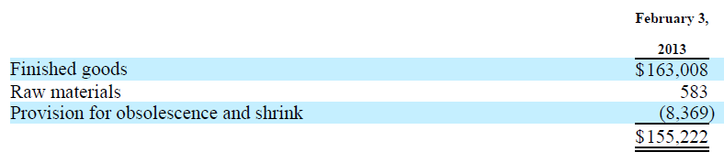
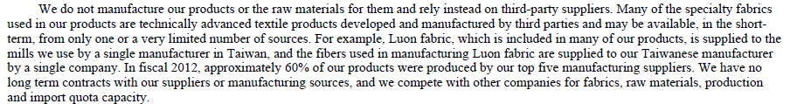
Lululemon’s Obsolete Inventory [FYE 02/03/2013]
(in thousands)
Why are raw materials such a small % of total inventory?

Slide 56
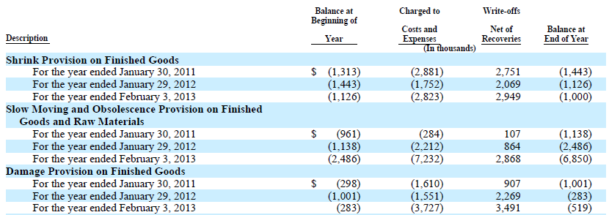
Lululemon’s Obsolete Inventory [FYE 02/03/2013]
(in thousands)

Slide 57
KEURIG GREEN MOUNTAIN, INC.
(formerly, Green Mountain Coffee Roasters)

Slide 58
GMCR Earnings Press Release (Nov. 27, 2012)
Green Mountain Coffee Roasters, Inc. Reports Fourth Quarter and Fiscal Year 2012 Results
Fourth Quarter Fiscal 2012 Revenue Increases 33%, GAAP EPS Up 23%, Non-GAAP EPS Grows 36%;
Fiscal Year 2012 Revenue Increases 46%, GAAP EPS Up 74% and Non-GAAP EPS Grows 46%; Company Generates $77 million in Free Cash Flow for the Year
Green Mountain Coffee Roasters reported 64 cents per share in non-GAAP earnings which beat analyst estimates by 16 cents.
However, it appears that changes in inventory obsolescence may have contributed heavily to Green Mountain beating estimates.

Slide 59
GMCR 2012 Q3 10-Q (Aug. 1, 2012)
Gross Profit
Gross profit for the 2012 YTD period was $953.0 million, or 32.7% of net sales, as compared to $650.5 million, or 33.5% of net sales, in the prior year period. Gross margin declined approximately (i) 290 basis points due to under-utilization of our current manufacturing base as a result of lower than expected manufacturing through-put primarily due to lower K-Cup® pack demand and lower-than-planned production levels which increased average labor and overhead costs per K-Cup® pack, (ii) 140 basis points due to higher green coffee costs, and (iii) 100 basis points due to a higher write down of finished product and anticipated obsolescence of raw material inventory due to lower than anticipated sales of seasonal and certain coffee products. The decrease in gross margin was partially offset by (i) a 290 basis point increase due to net price realization primarily from price increases taken in fiscal 2011 to offset higher green coffee and other input costs that were experienced in fiscal 2011 and the first half of fiscal 2012, (ii) a 40 basis point increase due to price increases on Keurig® Single Cup Brewers in fiscal 2011, and (iii) a 40 basis point increase due to the decrease in 2012 YTD warranty expense related to Keurig® Single Cup Brewers.
To estimate the amount of inventory obsolescence charged to COGS, multiply sales by the amount of the charge. In this case, for thirty-nine weeks ended June 23, 2012, GMCR reported sales of $2,912,462,000. Multiplying the sales figure by 100 bps gives you a charge of $29,124,620.

Slide 60
GMCR 2012 10-K (Nov 28, 2012)
Gross Profit
Gross profit for fiscal 2012 was $1,269.4 million, or 32.9% of net sales, as compared to $904.6 million, or 34.1% of net sales, in fiscal 2011. Gross margin declined approximately (i) 220 basis points due to higher labor and overhead manufacturing costs associated with the ramp-up in our manufacturing base, (ii) 80 basis points due to higher green coffee costs, (iii) 70 basis points due to a higher write down of inventories, including finished goods and raw materials, due to lower than anticipated sales of seasonal and certain coffee products, and (iv) 50 basis points due to the launch of our new Keurig® Vue® Brewing system that has a lower gross margin than the Keurig® K-Cup® Brewing system. The decrease in gross margin was partially offset by (i) a 260 basis point increase due to net price realization primarily from price increases taken in fiscal 2011 to offset higher green coffee and other input costs that were experienced in fiscal 2011 and the first half of fiscal 2012, and (ii) a 40 basis point increase due to the decrease in fiscal 2012 warranty expense related to Keurig® Single Cup Brewers.
For the fifty-three weeks ended September 29, 2012, Green Mountain reported sales of $3,859,198,000. Multiplying the sales figure by the 70 basis points gives you $27,014,386

Slide 61
GMCR 2012 10-K (Nov 28, 2012)
So for the cumulative thirty-nine weeks ended June 23, 2012, GMCR charged approximately $29M in obsolete inventory to the cost of goods sold account. By the time the end of the year rolled around the charge was only $27M, $2M less than it took for the thirty-nine week period.
What happened to account for the $2M difference in inventory obsolescence between the end of the third quarter and the end of the fiscal year?
 | For the 39 weeks ended June 23, 2012 | For the 53 weeks ended Sept. 29, 2012
Sales | $2,912,462,000 | $3,859,198,000
Inventory Obsolescence | 1.00% | 0.70%
Charge | $29,124,620 | $27,014,386
Difference |  | ($2,110,234)

Slide 62
GMCR 2012 10-K (Nov 28, 2012)
The $2M difference is especially curious in light of GMCR’s increasing Days Inventory Outstanding (DIO increased to 112 days from 108 days for the same quarter last year)
It’s important to note that this rise in inventory occurred despite GMCR beating its own estimates for sales. If Green Mountain sold more products than they anticipated, DIO should have decreased rather than increased.
It is odd to incur obsolescence charges for inventory for the first nine months of the year, have an increase in inventory levels for the next three months, and not incur any additional inventory obsolescence charges.
Is it possible GMCR relied on reducing or reversing inventory obsolescence charges to beat earnings estimates?
 | For the 14 weeks ended September 29, 2012 | For the 13 weeks ended Sept. 24, 2011
COGS | $630,290 | $457,793
Ending Inventory | $768,437 | $672,248
Beginning Inventory | $667,005 | $417,496
Days Inventory Outstanding | 111.59 | 108.31

Slide 63
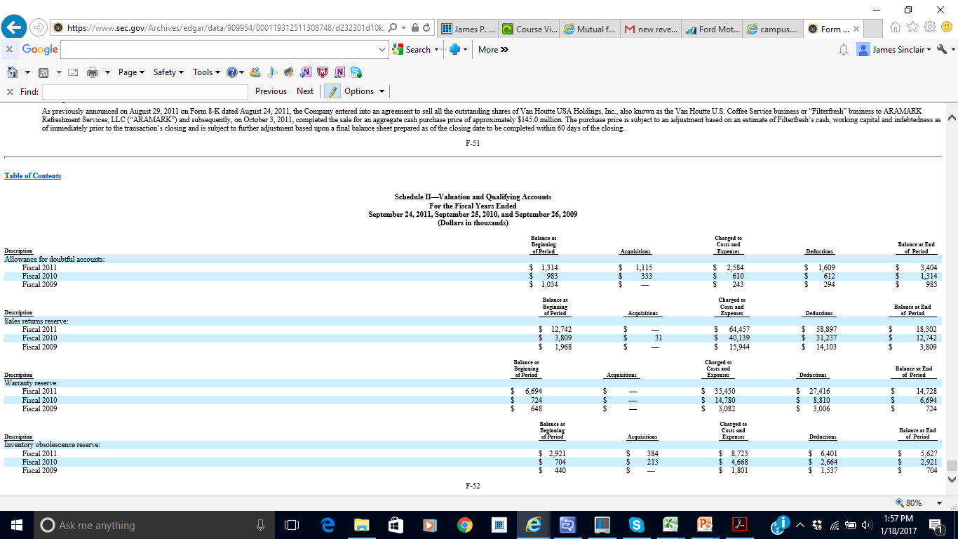
GMCR 2011 10-K

Slide 64
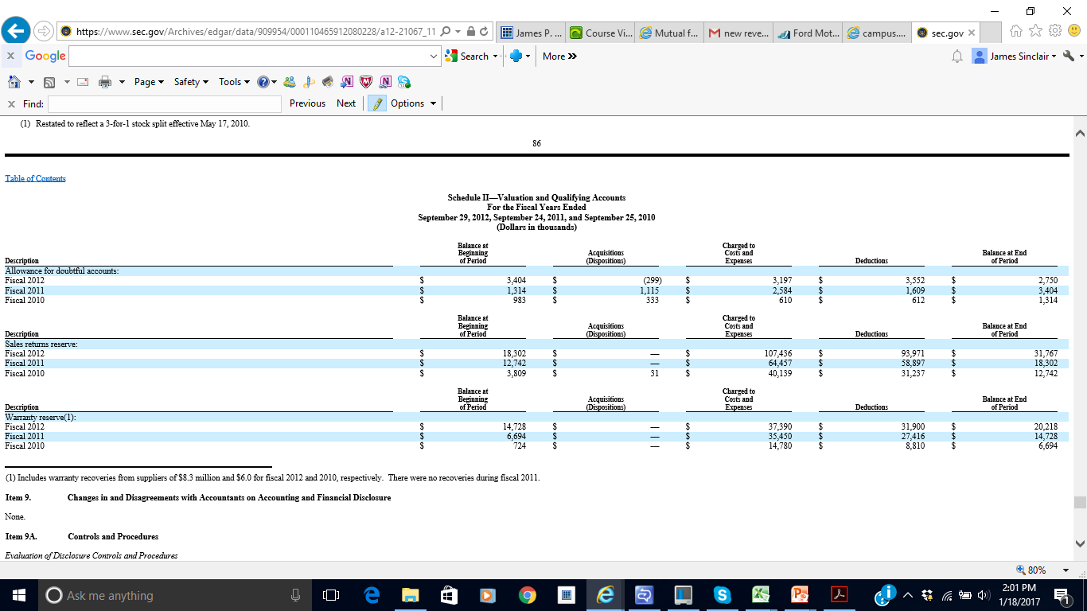
GMCR 2012 10-K

Slide 65
‘Real’ Earnings Management Opportunity for Manufacturing Firms

Slide 66
‘Real’ Earnings Management
All product costs (i.e., raw materials, labor, overhead) are parked in inventory (asset) until product is sold
Upon sale, product costs are recognized on the income statement under Cost of Goods Sold (expense)
Fixed overhead is typically allocated on a per unit of production basis
See example on next slide...

Slide 67
Earnings Management: How can managers do it?
Example: Overproduction
Firm A has the capacity to produce 150,000 units per period. Consider the following per unit product costs for Firm A:
Raw materials $215
Direct labor $125
Variable overhead $ 70
Firm A also incurs $42 million in fixed overhead costs per period.
Projected (and actual) sales equal 110,000 units.
Scenario A: Produce 120,000 units |  |  |  | Scenario B: Produce 150,000 units
Per Unit | Units Sold | Total |  | Per Unit | Units Sold | Total
$215 | x110,000 | $23,650,000 | Raw Materials | $215 | x110,000 | $23,650,000
$125 | x110,000 | $13,750,000 | Labor | $125 | x110,000 | $13,750,000
$ 70 | x110,000 | $7,700,000 | Variable Overhead | $ 70 | x110,000 | $ 7,700,000
$350 ($42M / 120k) | x110,000 | $38,500,000 | Fixed Overhead ($42,000,000) | $280 ($42M / 150k) | x110,000 | $30,800,000
$760 |  | $83,600,000 | Cost of Good Sold | $690 |  | $75,900,000

Slide 68
Inventory Errors

Slide 69
Inventory Errors
The ending inventory amount on the balance sheet should include ALL inventory owned by the firm at the balance sheet date
Inventory errors can arise due to:
getting the physical count wrong
some inventory on hand has been sold
some inventory is not yet on hand but has been purchased
outbound inventory in transit to a customer if FOB destination
inbound inventory in transit to the firm if FOB shipping
Why are periodic inventory systems more susceptible to errors than perpetual inventory systems?

Slide 70
Inventory Errors Example
Milan, LLC uses a periodic inventory system and ordered $2M of merchandise in December 2015. The contract stipulates “F.O.B. Shipping” and the goods were shipped on 12/28/2015 (so Milan increased its Purchases and A/P accounts on 12/28/2015) and arrived at Milan’s warehouse on 01/03/2016. Milan’s physical inventory count on 01/01/2016 at 6:00am did not include these goods.
How are Ending Inventory, COGS, and Net Income in 2015 and 2016 affected by this error?

Slide 71
Inventory Errors Example
Assume the following information for 2015:
No Error With Error
Beginning Inventory 10 10
+ Purchases (including $2M) +20 +20
= Goods Available for Sale 30 30
‒ Ending Inventory -19
= Cost of Goods Sold 11
Effect of Error on Ending Inventory at 12/31/2015:
Too low
Effect of Error on COGS in 2015:
Too high
Effect of Error on Net Income in 2015:
Too low
-17 “too low”
13 “too high”

Slide 72
Inventory Errors Example
Assume the following information for 2016:
No Error With Error
Beginning Inventory 19
+ Purchases +40 +40
= Goods Available for Sale 59
‒ Ending Inventory -25 -25*
= Cost of Goods Sold 34
Because ending inventory at 12/31/2016 is determined by a physical count on 1/1/2017 and there is no counting error on this date, 2016 ending inventory is not affected by the counting error on 1/1/2016.
Effect of Error on Ending Inventory at 12/31/2016:
No effect
Effect of Error on COGS in 2016:
Too low (b/c Beg. Inv. is understated)
Effect of Error on Net Income in 2016:
Too high
17 “too low”
57 “too low”
32 “too low”
NOTE: Error is “counter-balancing” (too much COGS in 2015; not enough in 2016). As of the end of 2016, the error has corrected itself

Slide 73
Ratio Analysis

Slide 74
Inventory Turnover
How efficiently does a firm manage its inventory?
As mentioned earlier, the primary goals of inventory management are to have sufficient quantities of high-quality inventory available to serve customers’ needs while minimizing the costs of carrying inventory. The inventory turnover ratio is an important measure of the company’s success in balancing these conflicting goals.
The inventory turnover ratio is calculated as cost of goods sold divided by average inventory. Average inventory is the beginning inventory plus the ending inventory divided by two.
This ratio reflects how many times average inventory was produced and sold during the period. A higher ratio indicates that inventory moves more quickly, thus reducing storage and obsolescence costs.
Cost of Goods Sold
Average Inventory
Inventory Turnover
=

Slide 75
Average Days to Sell Inventory
How efficiently does a firm manage its inventory?
This ratio reflects the average time in days it takes a company to produce and deliver inventory to its customers. Generally, a lower ratio is better as it indicates a quicker delivery cycle to customers.
An organization’s average days to sell inventory should only be compared to its own figures from prior years or to competitors, as significant differences often exist across industries.
Same as Days Inventory Outstanding, or DIO, from Chapter 3.
365
Inventory Turnover
Average Days to Sell Inventory
=

Slide 76
Internal Control of Inventory
After cash, inventory is the asset second most vulnerable to theft. Efficient management of inventory is crucial to avoid stock-outs and overstock situations. As a consequence, a number of control features focus on safeguarding inventories and providing up-to-date information for management decisions.
Key among these are:
Separation of responsibilities for inventory accounting and physical handling of inventory.
Storage of inventory in a manner that protects from theft and damage.
Limiting access to inventory to authorized employees.
Maintaining perpetual inventory records.
Comparing perpetual records to periodic physical counts of inventory.
Note: Errors in measuring ending inventory lead to errors in cost of goods sold. They have an inverse relationship.

Slide 77
Inventory and Cash Flows
When companies expand production to meet increases in demand, this increases the amount of inventory reported on the balance sheet. A change in inventories can have a major effect on a company’s cash flow from operations. Cost of goods sold on the income statement may be more or less than the amount of cash paid to suppliers during the period. Since most inventory is purchased on credit, reconciling COGS with cash paid to suppliers requires consideration of the changes in both the Inventory and Accounts Payable accounts.
When a net decrease in inventory for the period occurs, sales are greater than purchases, and thus, the decrease must be added in computing cash flows from operations.
When a net increase in inventory for the period occurs, sales are less than purchases, and thus, the increase must be subtracted in computing cash flows from operations.
Net Income
ADD
SUBTRACT
Decrease in Inventory
Increase in Inventory
Increase in Accounts Payable
Decrease in Accounts Payable
Cash Flow from Operations

Slide 78
Advanced Study Questions

Slide 79
Exxon Mobil Questions [work through on your own]
Consider these questions as challenging “bonus” material that tests whether you fully understand how accounting method changes impact a firm’s financial statements.

Slide 80
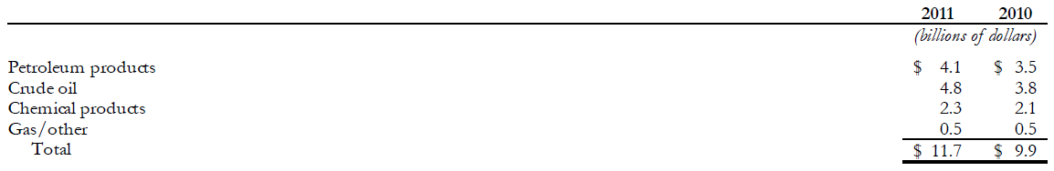
Exxon Mobil’s 2011 Inventory Disclosures
…The aggregate replacement cost of inventories was estimated to exceed their LIFO carrying values by $25.6 billion and $21.3 billion at December 31, 2011, and 2010, respectively.

Slide 81
Exxon Mobil Questions [work through on your own]
Q1: If ExxonMobil used FIFO instead of LIFO, what would its ending inventory value be as of 12/31/2011?
Q2: How much income tax has ExxonMobil cumulatively deferred as of 12/31/2011 because it uses LIFO and not FIFO? Assume a 35% statutory tax rate.
Q3: How much income tax did ExxonMobil defer in FY2011 because it uses LIFO and not FIFO? 2011 COGS_{LIFO} were $306.8B. Assume a 35% statutory tax rate.
Q4: How could ExxonMobil sell the same amount of inventory at the same sales price and still boost net income without switching from LIFO to FIFO?
Q5a: If ExxonMobil switched from LIFO to FIFO in 2011, what is the impact on its 2011 income statement (relative to continuing to use LIFO)?
Q5b: If ExxonMobil switched from LIFO to FIFO in 2011, what is the impact on its 2011 balance sheet (relative to continuing to use LIFO)?

Slide 82
Exxon Mobil Questions [work through on your own]
Q1: If ExxonMobil used FIFO instead of LIFO, what would its ending inventory value be as of 12/31/2011?
“Replacement cost” = Inventory valuation under FIFO
$11.7B Inventory_{LIFO}
+ $25.6B LIFO Reserve₂₀₁₁
$37.3B Inventory_{FIFO}

Slide 83
Exxon Mobil Questions [work through on your own]
Q2: How much income tax has ExxonMobil cumulatively deferred as of 12/31/2011 because it uses LIFO and not FIFO? Assume a 35% statutory tax rate.
= Cumulative LIFO Reserve₂₀₁₁ * Statutory Tax Rate
= $25.6B * 35% = $8.96 B

Slide 84
Exxon Mobil Questions [work through on your own]
Q3: How much income tax did ExxonMobil defer in FY2011 because it uses LIFO and not FIFO? 2011 COGS_{LIFO} were $306.8B. Assume a 35% statutory tax rate.
Short-Cut Calculation:
= ΔLIFO Reserve₂₀₁₁ * Statutory Tax Rate
= ($25.6B - $21.3B) * 35% = $4.3B * 35% = $1.51B

Slide 85
Exxon Mobil Questions [work through on your own]
Q3: How much income tax did ExxonMobil defer in FY2011 because it uses LIFO and not FIFO? 2011 COGS_{LIFO} were $306.8B. Assume a 35% statutory tax rate.
Here is why the short-cut method works:
Solve for Purchases using the Inv_{LIFO} T-account
Use that value to solve for COGS_{FIFO} in the Inv_{FIFO} T-account
Inventory_{LIFO}
Inventory_{FIFO}
9.9
308.6
306.8
11.7
31.2
308.6
302.5
37.3
Purchases
COGS
COGS
2011 COGS_{LIFO} of $306.8B > COGS_{FIFO} of $302.5B by $4.3B
Thus, the change in the LIFO reserve is the value that COGS differed in the current period under LIFO versus under FIFO
Additional $4.3B of COGS_{LIFO2011} lowered income taxes by $1.51B (= $4.3B * 35%)

Slide 86
Exxon Mobil Questions [work through on your own]
Q4: How could ExxonMobil sell the same amount of inventory at the same sales price and still boost net income without switching from LIFO to FIFO?
Liquidate a LIFO layer (which has a lower cost basis)

Slide 87
Exxon Mobil Questions [work through on your own]
Q5a: If ExxonMobil switched from LIFO to FIFO in 2011, what is the impact on its 2011 income statement (relative to continuing to use LIFO)?
COGS:
Income Tax Expense:
Net Income:
EPS boost from switching from LIFO to FIFO!
$4.30B lower
DR Inventory (A) 4.3B
CR COGS (E) 4.3B
$1.51B higher
DR Tax Expense (E) 1.51B
CR Taxes Payable (L) 1.51B
$2.79B higher

Slide 88
Exxon Mobil Questions [work through on your own]
Q5b: If ExxonMobil switched from LIFO to FIFO in 2011, what is the impact on its 2011 balance sheet (relative to continuing to use LIFO)?
Δ Inventory:
Δ Income Taxes Payable:
Δ Retained Earnings:

Slide 89
Exxon Mobil Questions [work through on your own]
Q5b: If ExxonMobil switched from LIFO to FIFO in 2011, what is the impact on its 2011 balance sheet (relative to continuing to use LIFO)?
Δ Inventory:
Ending inventory balance will increase by LIFO reserve amount ($25.6B)
We already said $4.3B of the inventory increase would decrease COGS. What is the offsetting account for the remaining $21.3B?
Less COGS should also have been recognized in prior periods, so R/E should be higher
DR Inventory (A) 21.3B
CR Retained Earnings (OE) 21.3B
$25.6B (=$4.3₂₀₁₁ + $21.3B_{prior periods})

Slide 90
Exxon Mobil Questions [work through on your own]
Q5b: If ExxonMobil switched from LIFO to FIFO in 2011, what is the impact on its 2011 balance sheet (relative to continuing to use LIFO)?
Δ Income Taxes Payable:¹
COGS_{LIFO} was higher in the past so the firm paid less tax
Switching to FIFO means $8.97B of taxes become due (=35% of 25.6B LIFO Reserve)
We already said $1.51B of the increase in taxes payable would increase tax expense. What is the offsetting account for the remaining $7.46B?
More tax expense should have been recognized in prior periods, so R/E should be lower
¹Technical details: If the cumulative effect of an accounting method change is taxpayer unfavorable (i.e., increases a firm’s U.S. tax liability), the IRS allows the firm to pay the liability ratably over four years [IRC §481(a)]. So only 25% of the additional balance is due in 2011.
$8.97B (=$1.51₂₀₁₁ + $7.46B_{prior periods})
DR Retained Earnings (OE) 7.46B
CR Taxes Payable (L) 7.46B

Slide 91
Exxon Mobil Questions [work through on your own]
Q5b: If ExxonMobil switched from LIFO to FIFO in 2011, what is the impact on its 2011 balance sheet (relative to continuing to use LIFO)?
Δ Retained Earnings:
Δ Retained Earnings
$16.63B
4.30B
1.51B
21.30B
7.46B
8.97B 25.60B
16.63B
Due to less COGS in 2011
Due to more tax expense in 2011
Due to less COGS in prior years
Due to more tax expense in prior years
Same as cumulative tax savings!
Same as LIFO reserve at 12/31/2011!
After-tax effect of LIFO Reserve at 12/31/2011

Slide 92
End of Chapter 07

